Slide 1
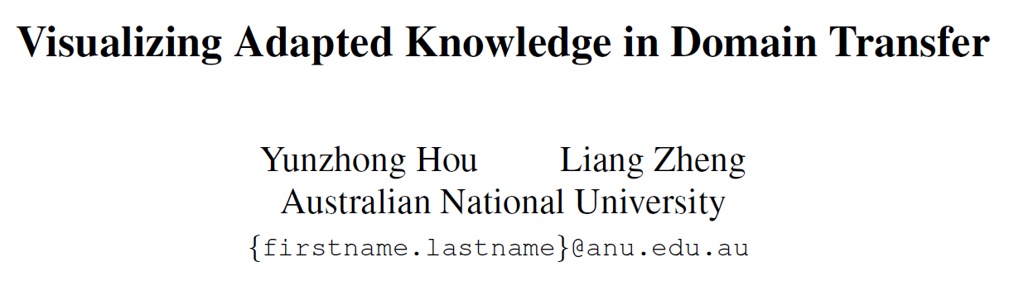
CVPR 2021
Jeonbuk National University, Korea
Multimedia Lab Under Prof. Park and Prof. Yoon
Mingle Xu
2022 Jan 14

Slide 2
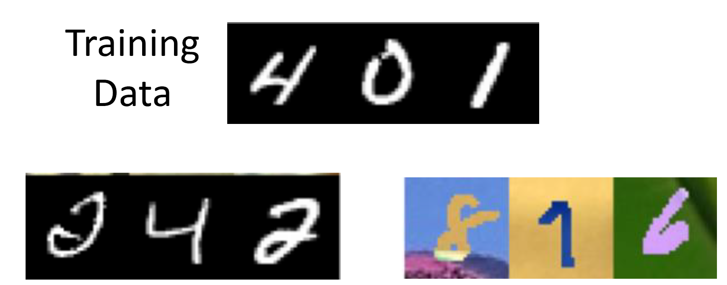
What is Domain Adaptation?
Train in Source Domain
Testing in Target Domain
The challenge: low performance in target domain
MNIST
Training
MNIST
Testing 99.5%
Three channels
MNIST-M
Testing 57.5%
Unsupervised Domain Adaptation by Backpropagation

Slide 3
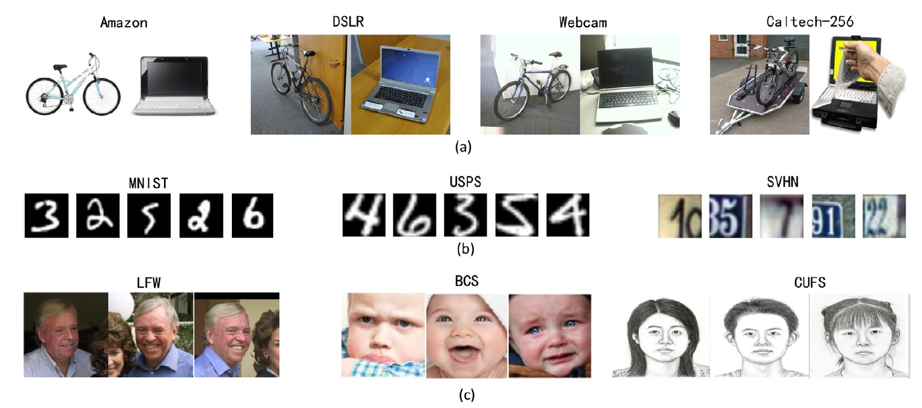
Related dataset or applications

Slide 4
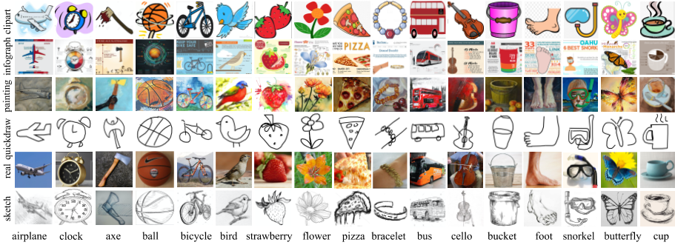
Related dataset or applications
VisDA dataset:
6 domains: real, clipart, info graph, painting, quick draw, sketch
17 classes.

Slide 5
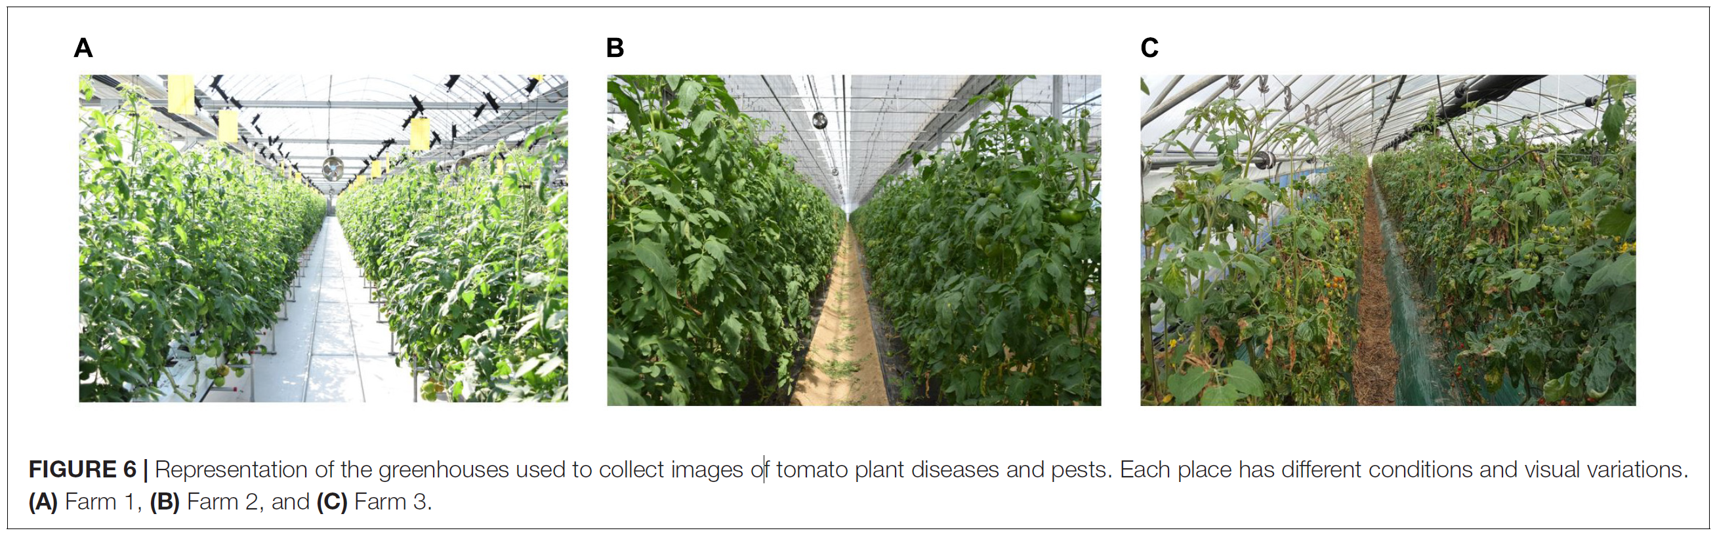
Domain adaption in our projects
Farms: type of tomato, background and facilities.
Species: tomato, strawberry, paprika.

Slide 6
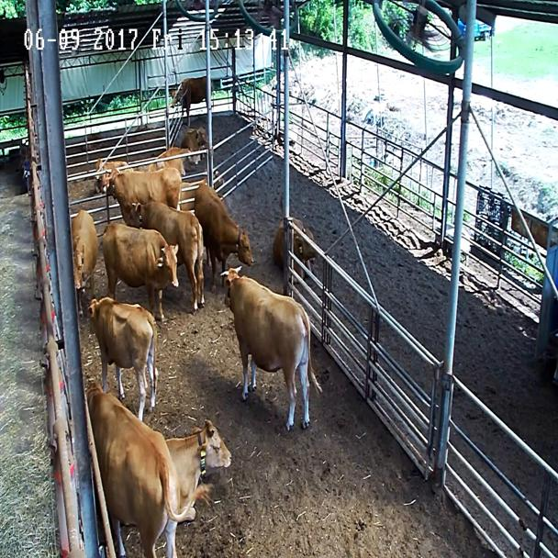
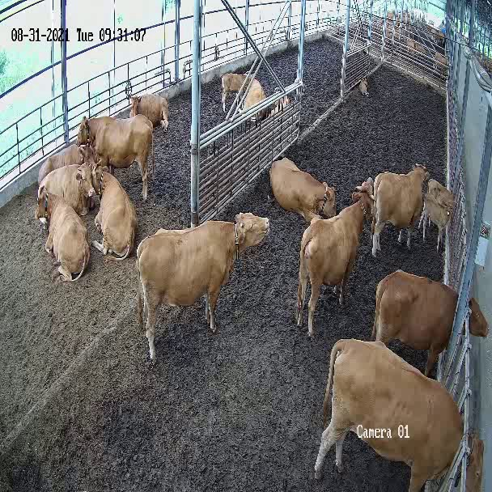
Domain adaption in our projects

Slide 7
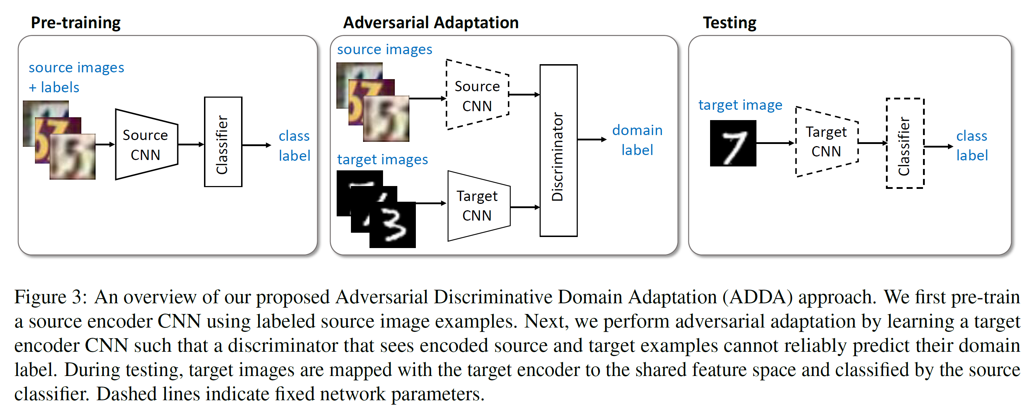
Background of Domain Adaptation
Basic idea: learn domain-invariant feature.
Adversarial Discriminative Domain Adaptation, 2017, CVPR

Slide 8
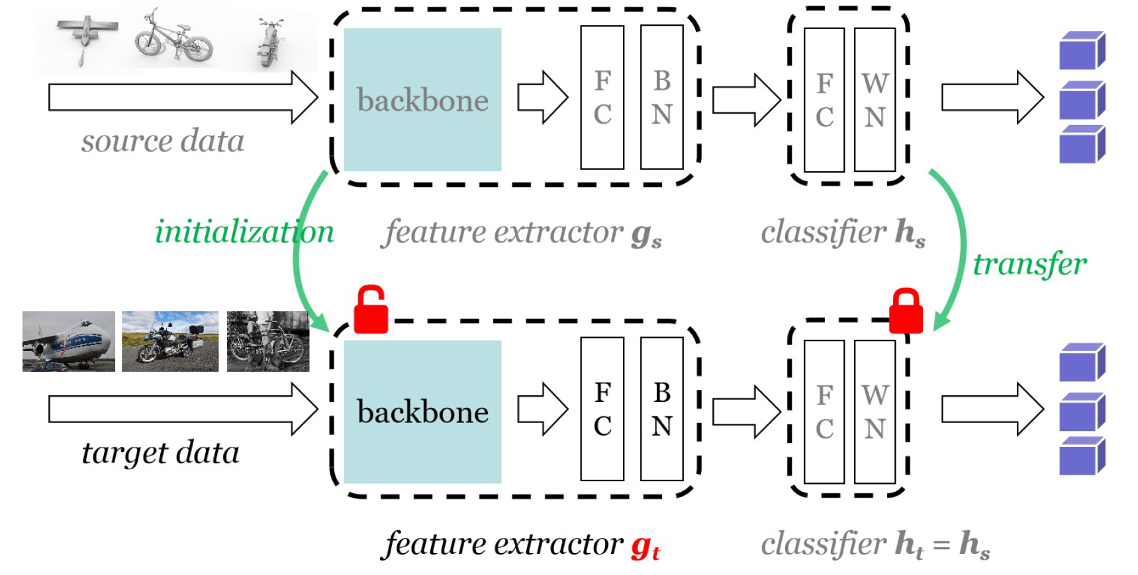
Background of Domain Adaptation
Can we do without access to the source data?
The character of the target feature: (Inception Score)
Individually certain: high score in one class for specific image
Globally diverse: many classes not only one
Distribution distance: source and target. (How about the class distribution is different in two domains?)
Do We Really Need to Access the Source Data? Source Hypothesis Transfer for Unsupervised Domain Adaptation, 2020, ICML

Slide 9
CVPR 2021
Jeonbuk National University, Korea
Multimedia Lab Under Prof. Park and Prof. Yoon
Mingle Xu
2022 Jan 14

Slide 10
The interested challenge in this paper
UDA: unsupervised domain adaptation,
Source domain: images with annotation
Target domain: images without annotation
What is the difference between the target and source model?
What did the model learn?

Slide 11
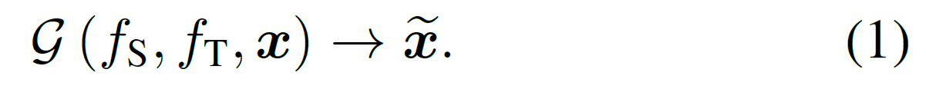
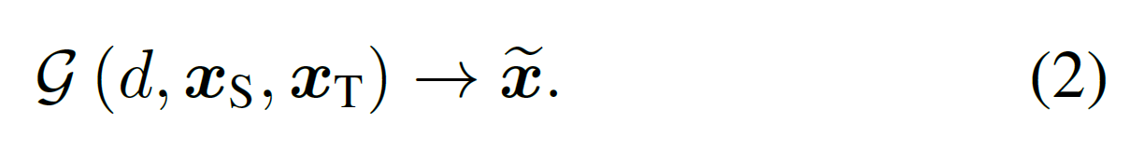
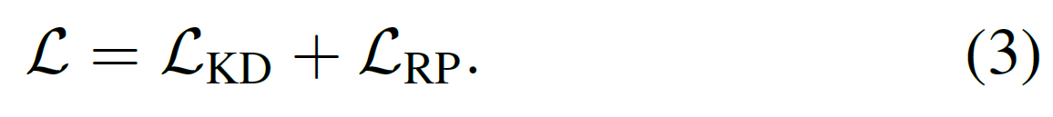
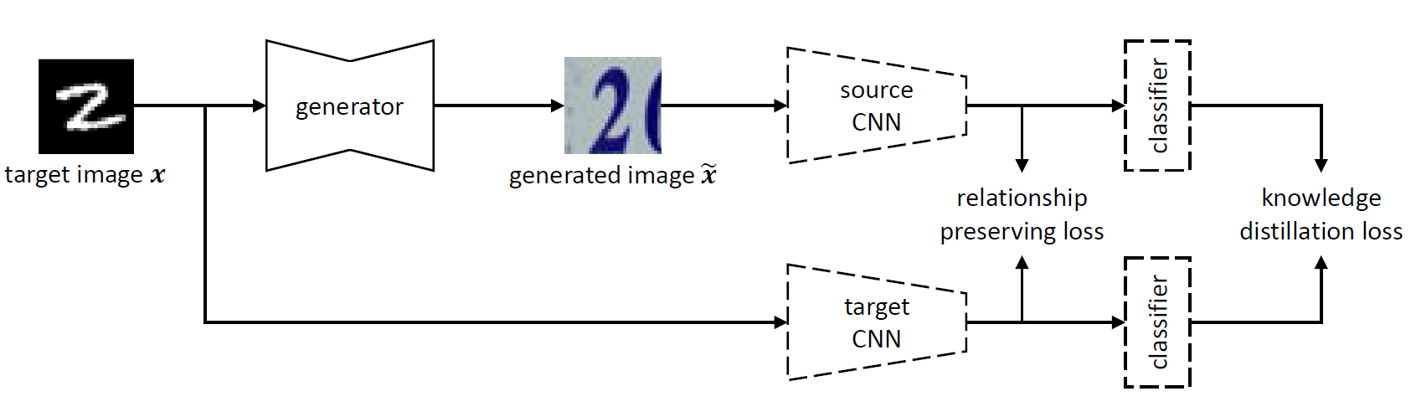
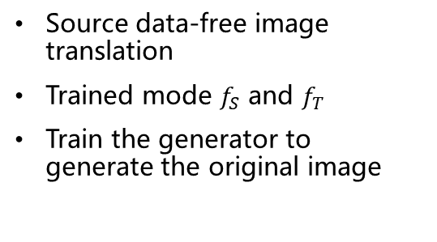
The proposed method
Source data-free image translation
Trained mode $f_{S}$ and $f_{T}$
Train the generator to generate the original image
Only feature extractor is adapted, not the classifier

Slide 12

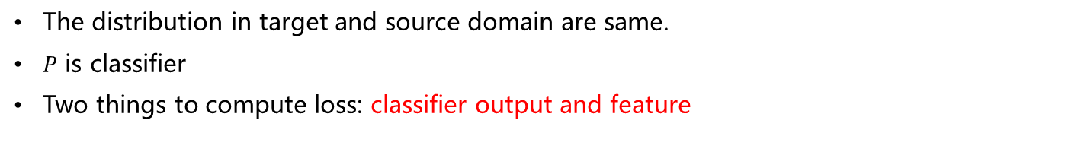
The loss function: the classification
The distribution in target and source domain are same.
$P$ is classifier
Two things to compute loss: classifier output and feature

Slide 13
How to compute the difference between two feature map before introducing the relationship preserving loss
Tips: element-wise loss

Slide 14
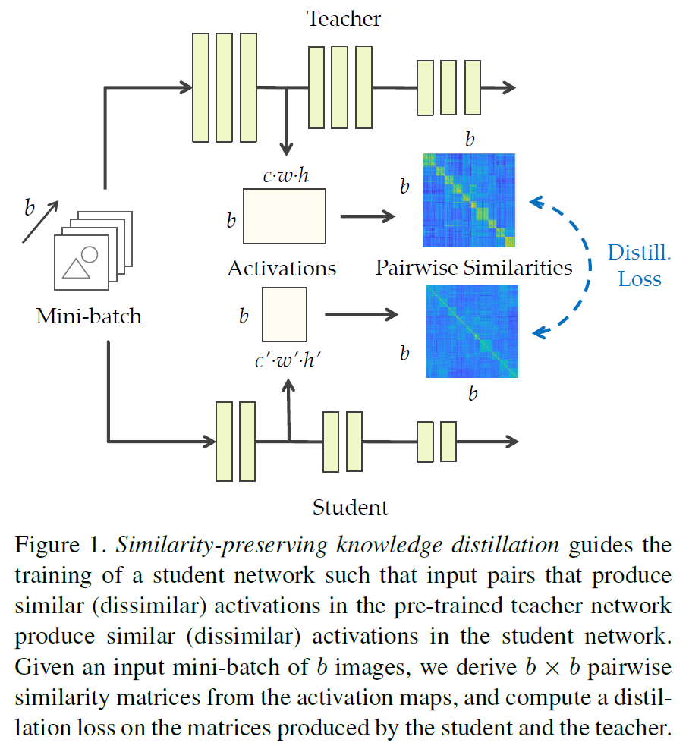
Related works to compute feature relation
Batch wise
Similarity-Preserving Knowledge Distillation, 2019, ICCV

Slide 15
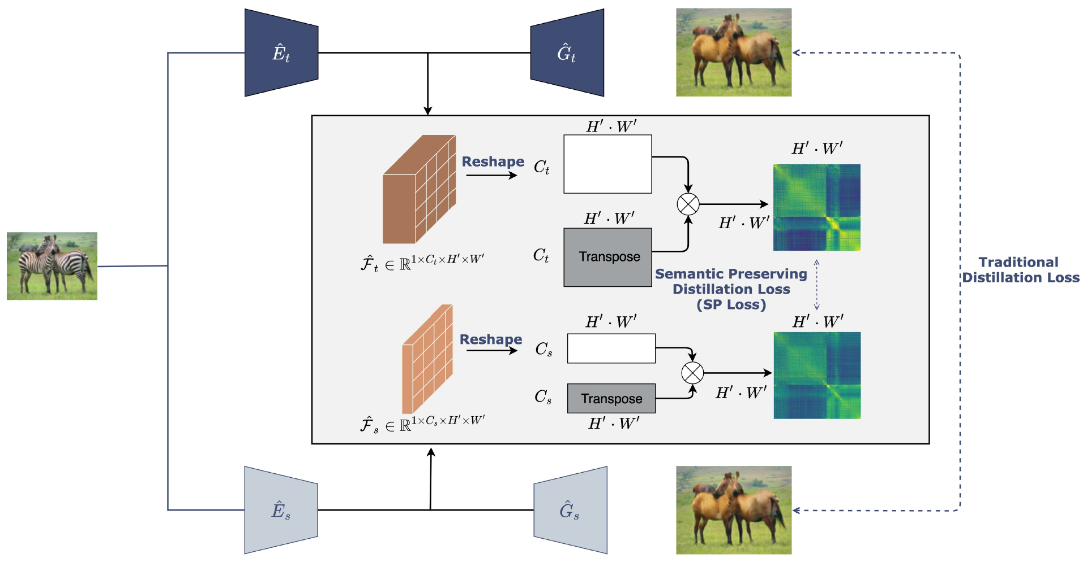
Related works to compute feature relation
Pixel wise
Semantic Relation Preserving Knowledge Distillation for Image-to-Image Translation, 2020, ECCV

Slide 16
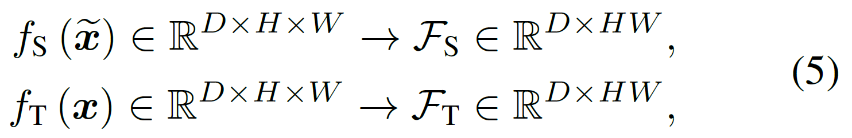

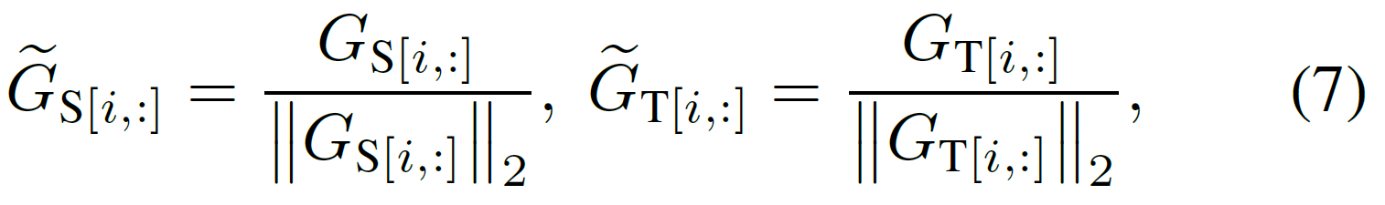
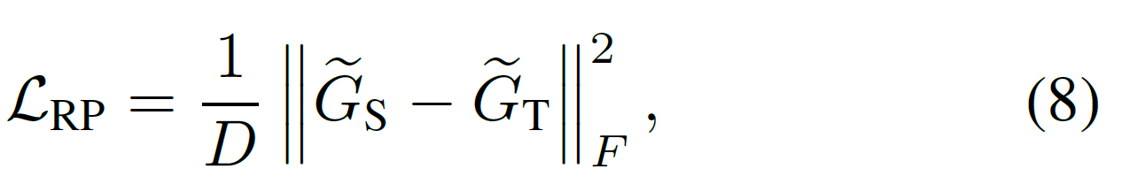
The loss function: feature
This paper is channel wise
Reshape and compute self correlation (Gram matrices)
Row-wise normalization
Relationship preserving loss

Slide 17
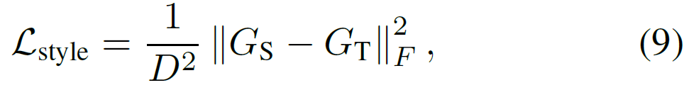
Relationship preservation loss
Relationship preservation loss is a normalized style loss

Slide 18
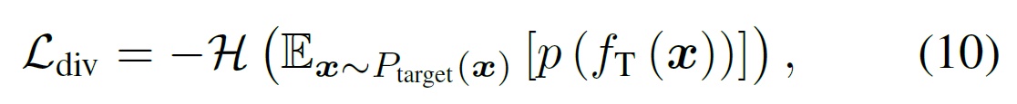
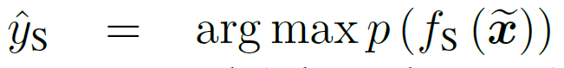
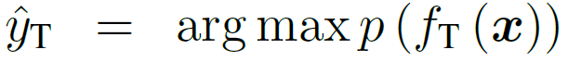
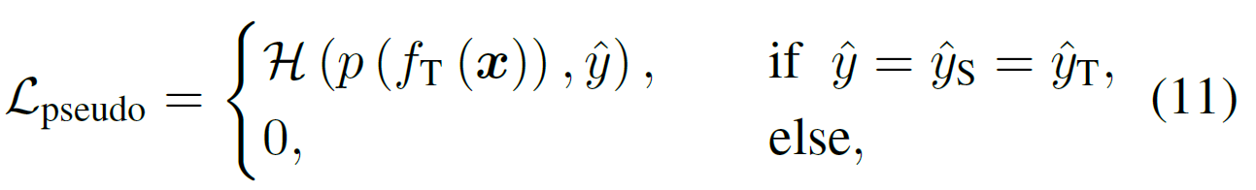
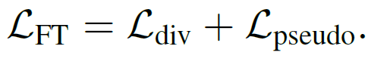
Why from target to source domain?
Finetuning the target model without source image.
Assume: even class (every class has same number of images)
Generate pseudo label
Final loss

Slide 19
Experiments
Datasets: digits, office-31, VisDA
Source and target model from SHOT-IM
Generator: CycleGAN
Initializing the generator: output is same as input

Slide 20
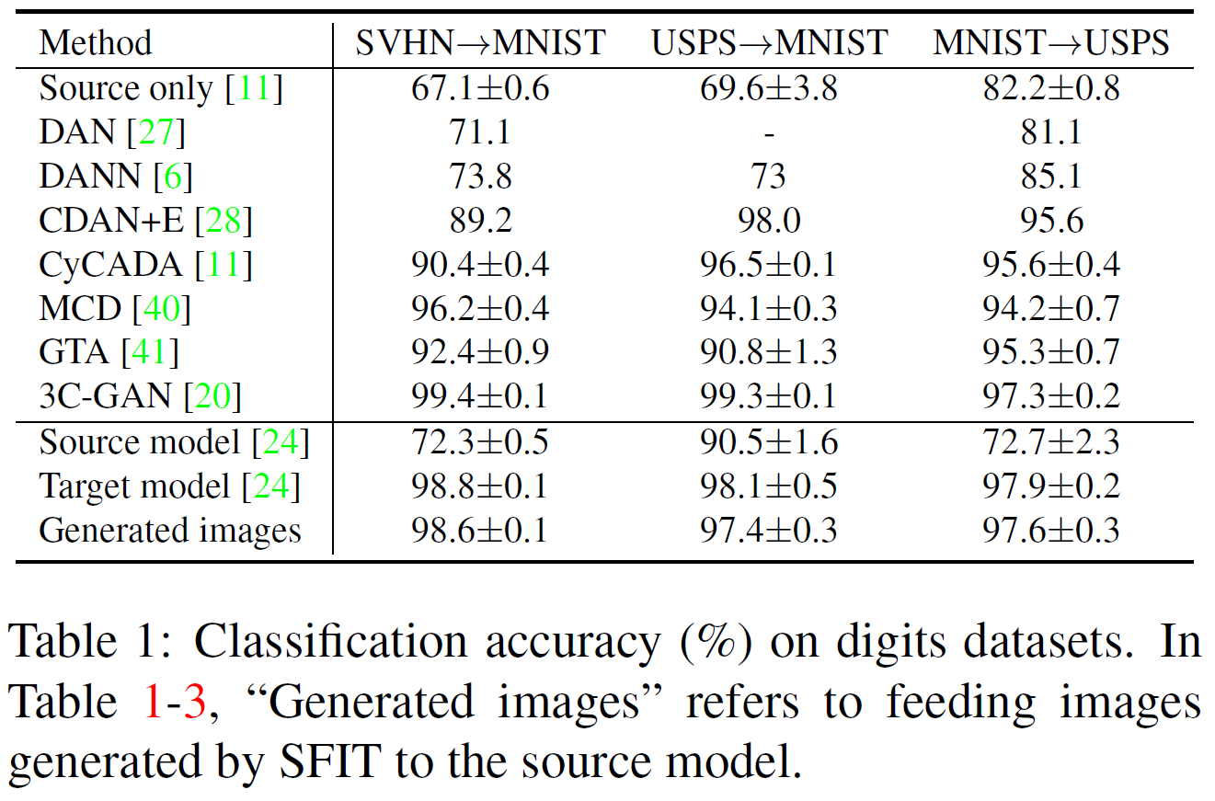
Experiments: recognition accuracy on the generated images

Slide 21
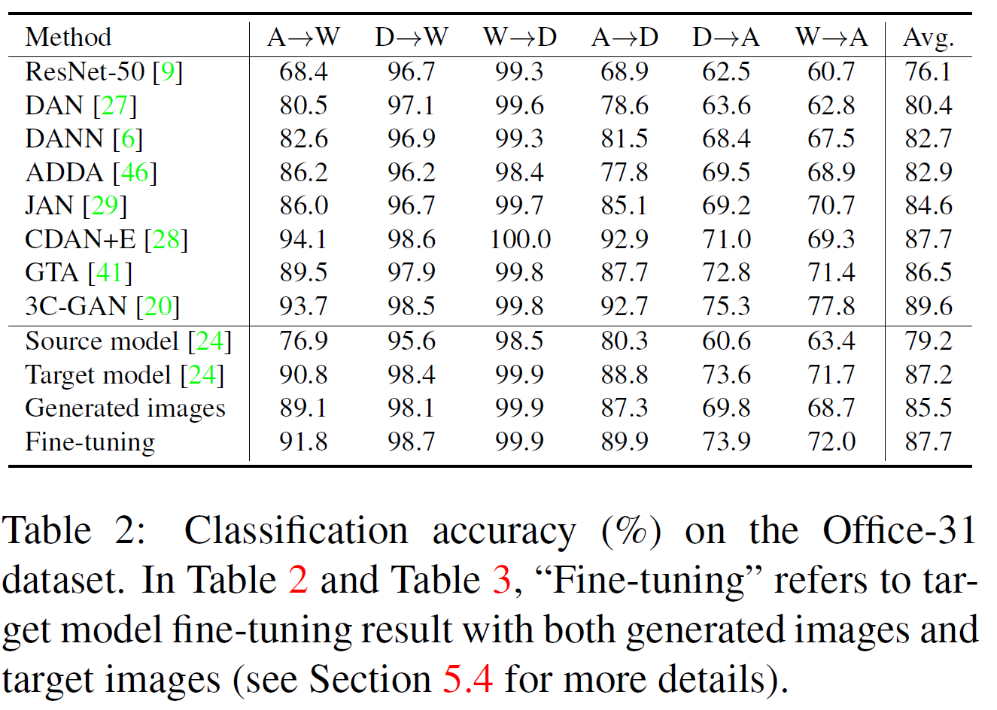
Experiments: recognition accuracy on the generated images

Slide 22
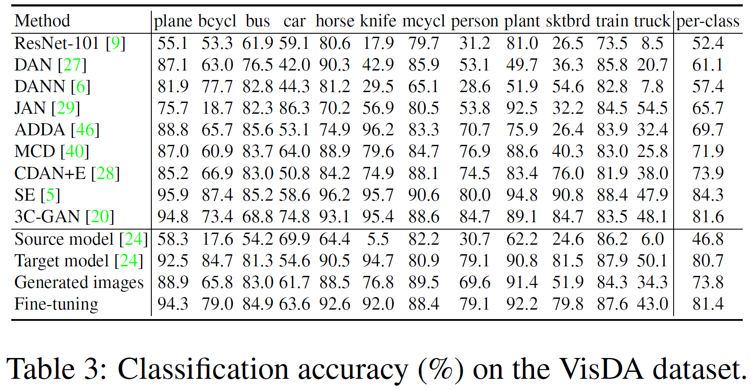
Experiments: recognition accuracy on the generated images

Slide 23
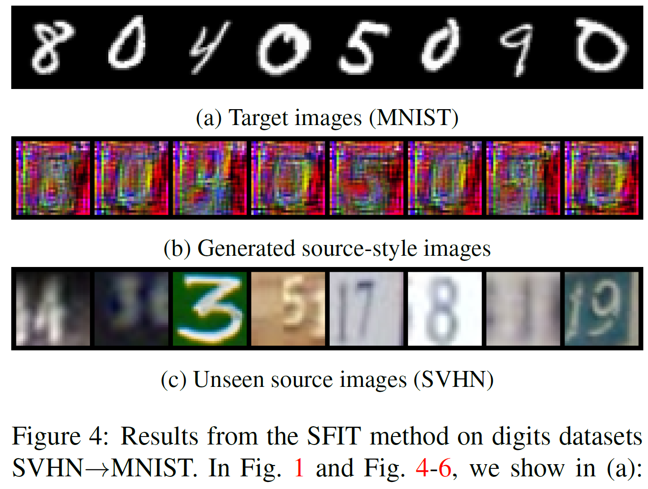
Visualization of the generated images
LeNet is a weaker classifier.

Slide 24
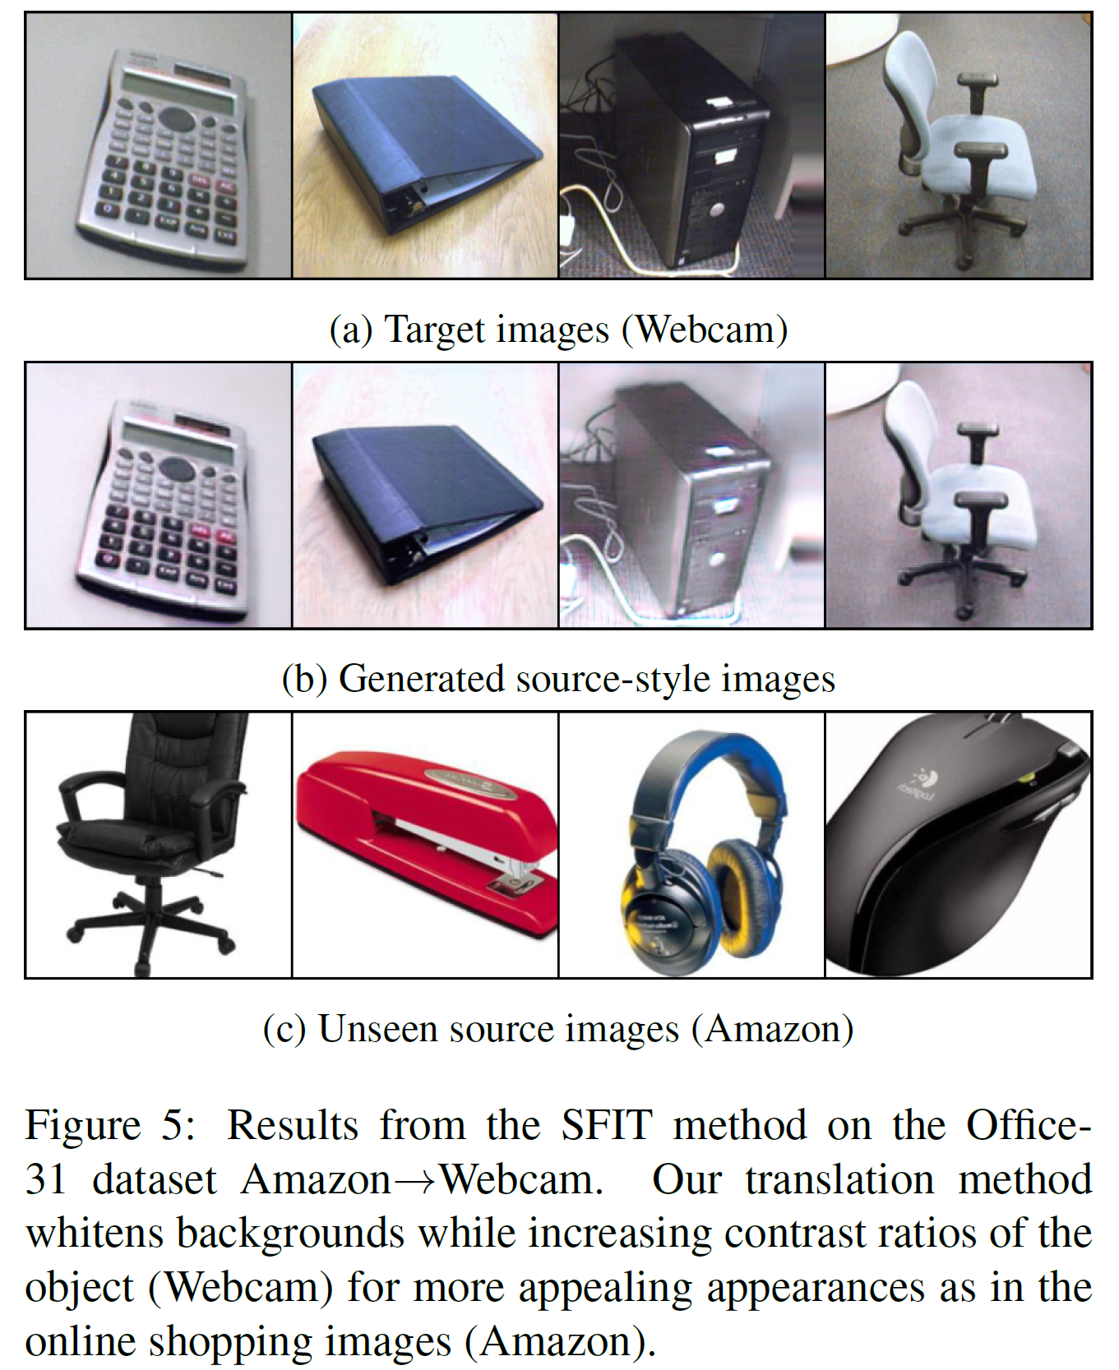
High contrast
Clean background
ResNet, not LeNet

Slide 25
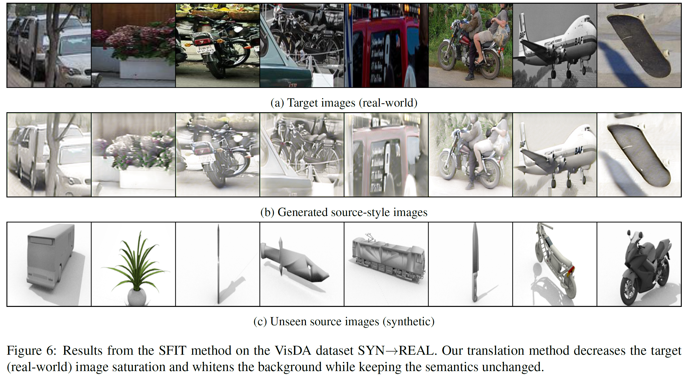
Saturation, background

Slide 26
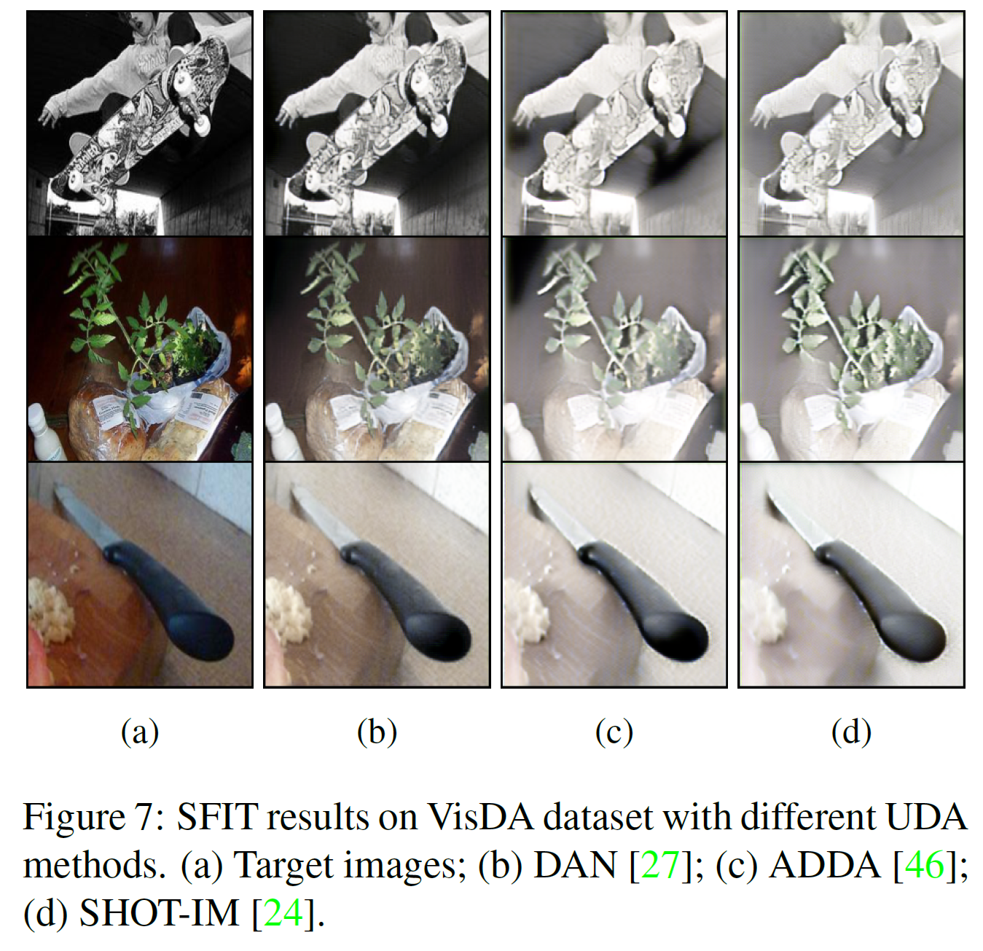
Comparison of various domain adaptation models
Visualize the domain adaptation model.

Slide 27
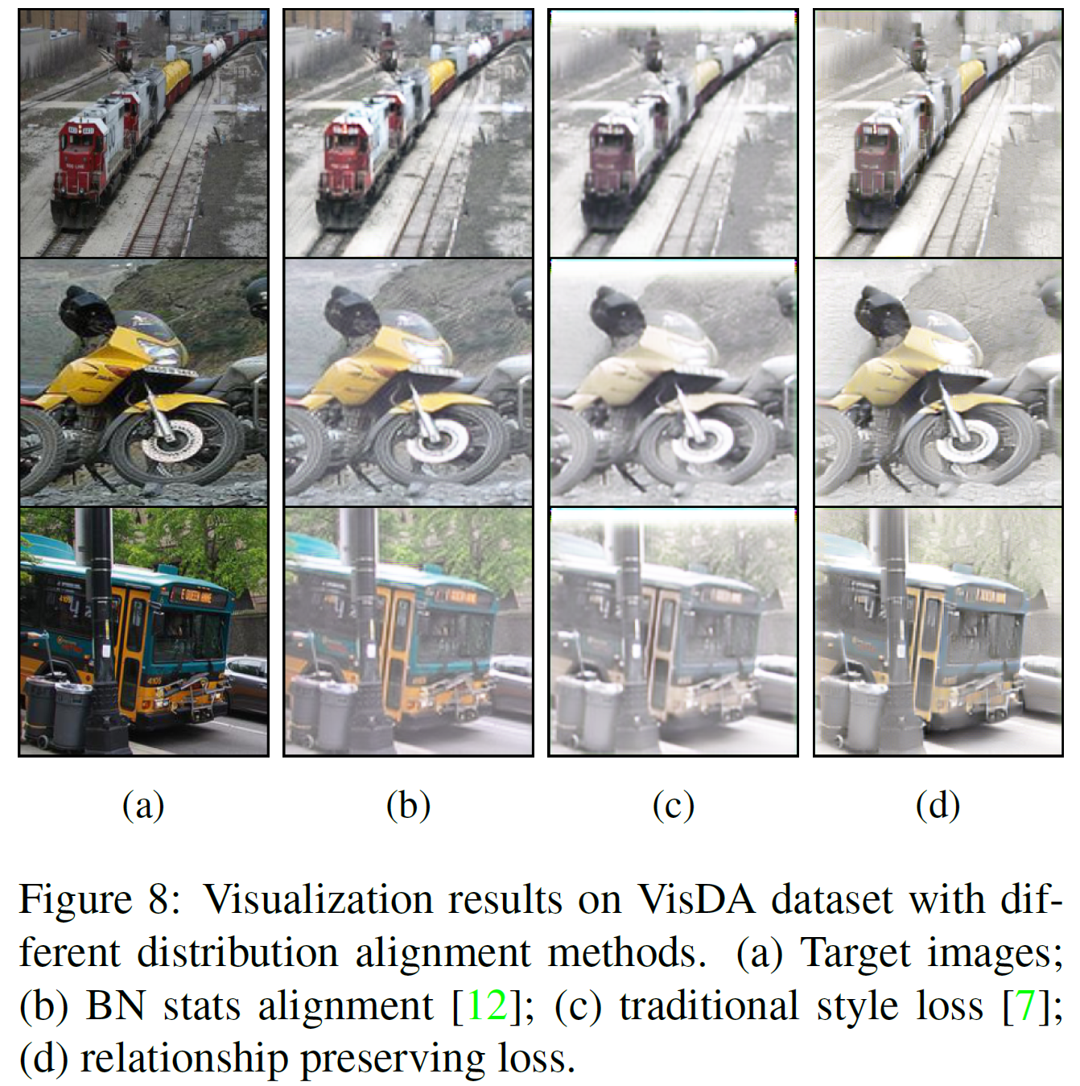
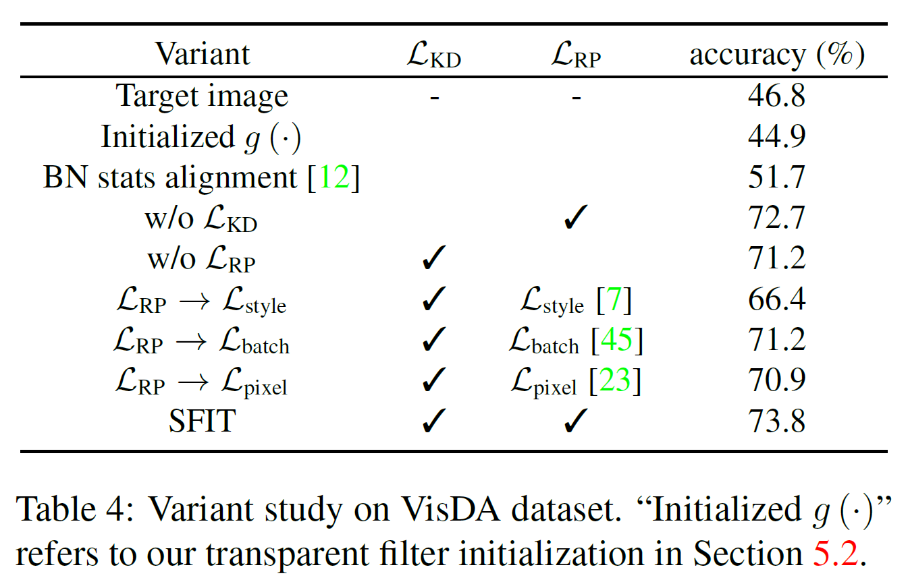
Ablation study

Slide 28
Conclusion
Image translation to visualize the domain adaptation.
Visualize the style change
Finetuning the model.

